Slide 1
Course - DT228-2
Module (Subject) -
Human Computer Interaction
Semester 2, Week 1
USERS AND INTERFACES

Slide 2
HCI
Human-Computer Interaction (HCI) is:
“…concerned with the design, evaluation and implementation of interactive computing systems for human use and with the study of major phenomena surrounding them.” (ACM SIGCHI, 1992, p.6)

Slide 3
HCI (2)
Human Computer Interaction, in North America, is often referred to as CHI - Computer-Human Interaction, or MMI - Man-Machine Interface (MMI).
Human Computer Interface is the study of the interaction between people, computers and tasks.
Human-Computer Interaction involves the development and application of principals, guidelines and methods to support the design and evaluation of interactive systems.

Slide 4
The Goal of HCI
The goal of HCI is to enhance the interaction between humans and computer systems.

Slide 5
Overview: Map of Human Computer Interaction
Use and Context
Social Organization and Work
Human-Machine Fit and Adaptation
Application Areas
Human
Computer
Dialogue
Computer
Human
Techniques
Graphics
Information
A a
Processing
Language,
Dialogue
Dialogue
Communication
Input and
Genre
Architecture
and Interaction
Ergonomics
Output Devices
Example Systems
Evaluation
and Case Studies
Implementation
Techniques
Techniques and Tools
Design
Approaches
Development Process

Slide 6
The Interdisciplinary Nature of HCI
The disciplines associated with HCI include:
Computer Science
Psychology
Sociology
Anthropology
Ergonomics
Physiology
Design
Art
Engineering
Linguistics
Philosophy
Artificial Intelligence

Slide 7
Interdisciplines
Computer Science and Engineering
- for faster machines - for faster systems - as a means of building better interfaces
Psychology - to better understand the user - for modelling the user (as a thinking entity)
Sociology
- for group work and groupware

Slide 8
Interdisciplines (2)
Anthropology and Ergonomics
- for body shape and equipment design
Physiology
- for physical capabilities
Design
- for user interface layout
Art
- for aesthetics

Slide 9
Interdisciplines (3)
Linguistics
- for the language of commands
Philosophy
- To allow for contextual consistency
Artificial Intelligence
- for modelling the user (in relation to software)

Slide 10
HUman
Who is the ‘human’ of Human Computer Interaction?
The USER

Slide 11

Human - The User
To the user, information is input and output as:
Visual - seeing
Auditory - hearing
Haptic - touching (and being aware of location)
Movement - positioning

Slide 12
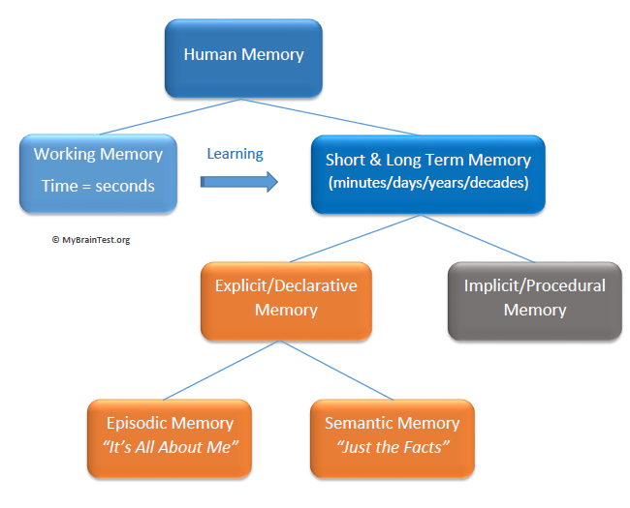
Human - The User (2)
To the user, information is stored in memory:
Sensory memory – visual, auditory, tactile
Short-term memory
Long-term memory

Slide 13
Human - The User (3)
To the user, information is processed and applied:
Reasoning,
Problem solving,
Skill,
Error

Slide 14
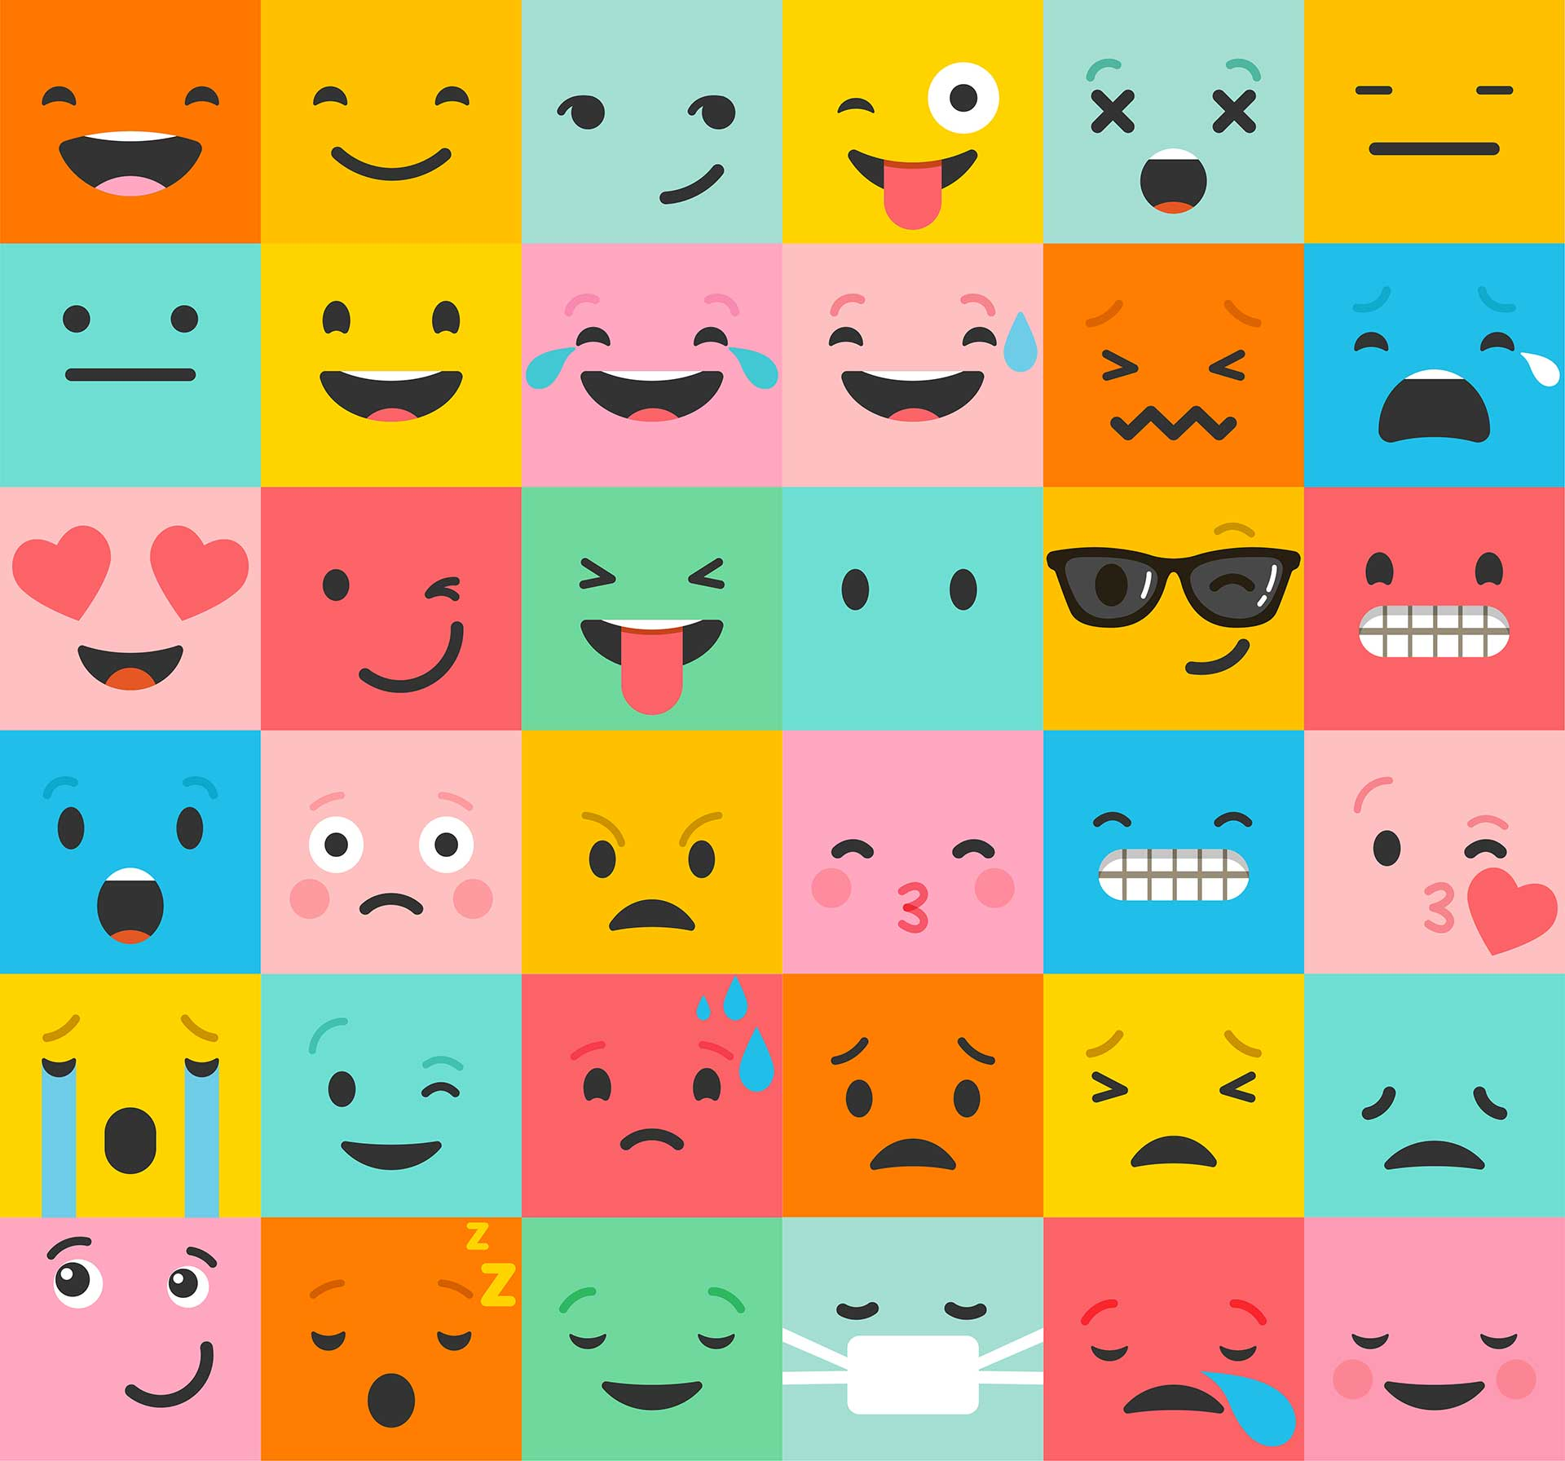
Human - The User (4)
Emotion influences human capabilities.

Slide 15

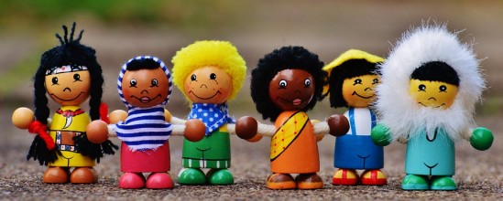
Human - The User (5)
As HCI designers, engineers, programmers…
we must remember
Each person is different

Slide 16
Human - The User (6)
Other considerations for the user:
Motivation
Enjoyment,
Satisfaction
Experience level…
… in or of their system use.

Slide 17
Computer
What is the ‘computer’ of Human Computer Interaction?
The SYSTEM

Slide 18
Computers
There is a huge range of types of computers and types of applications - HCI is a concern for all of them
GPS devices
Desktop PCs
Airport control systems
Smart TVs
Smart fridges
Wireless Devices
Laptops
Medical systems
Nuclear systems
Mainframes
Mobile phones
Web applications
etc etc
MP3 players
18

Slide 19
Use and Context of Computers
Problems of fitting computers, their uses, and the context of use together (1):
Social organisation and work…
where humans are interacting social beings
considers models of human activity:
Small groups, organisations, socio-technical systems, etc
relates to quality of work life…

Slide 20
Use and Context of Computers (2)
Problems of fitting computers, their uses, and the context of use together (2):
Application areas…
with characteristics of application domains, e.g. individual vs group work
may have popular styles in:
document production, communications, design, tutorials and help, multi-media information kiosks, continuous control (aircraft cockpits, factory systems’ process control), embedded systems (copiers, home appliances…)

Slide 21
Use and Context of Computers (3)
Problems of fitting computers, their uses, and the context of use together (3):
The ‘Human-Machine fit’, and adaptation…
to improve the fit between the designed object and its use:
how systems are selected and adopted; how users improvise routine systems; how systems adapt to the user (customisation); how users adapt to the system (training, ease of learning); user guidance (help, documentation, error-handling)

Slide 22
Interaction
What is the ‘interaction’ of Human Computer Interaction?
The PROCESS

Slide 23

Interacting With Computers
To understand human–computer interaction we need to understand computers and the processes associated with their systems.
What goes in and out Devices, Paper, Sensors, etc.
What can it do? Memory, Processing, Networks

Slide 24
Interacting With Computers (2)
Some years ago (30 – 40), computers performed batch processing
Punched card stacks or large data files were prepared
There was a long wait
Line printer output
… and if it is not right … start again!
These days most computing is interactive
Rapid feedback
The user in control (most of the time)
‘Doing rather than thinking.’
Is faster always better?

Slide 25
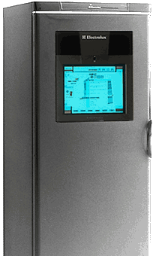
‘Rich’ Interaction
Sensors
and devices are
everywhere

Slide 26
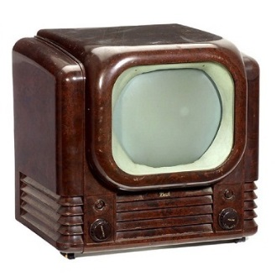
Why Study Human Use of Computer Systems?
The Business View:
To use humans more productively/effectively.
The human (employee?) costs now far outweigh hardware and software costs.
The Personal View:
People view a computer as an electrical appliance, and want it to perform as one.

Slide 27
Why Study Human Use of Computer Systems? (2)
The Marketplace View:
Everyday people are using computers:
they now expect “easy to use systems”
they are not tolerant of poorly designed systems
There is little vendor (who supply the computer system) control of training
Users are often see as a heterogeneous group
If product is hard to use, people will seek other products
EG Mac vs IBM (Microsoft Windows)

Slide 28
Why Study Human Use of Computer Systems? (3)
The System View:
There is a complex human
there is a complex computer…
so, a complex interface between the two.

Slide 29
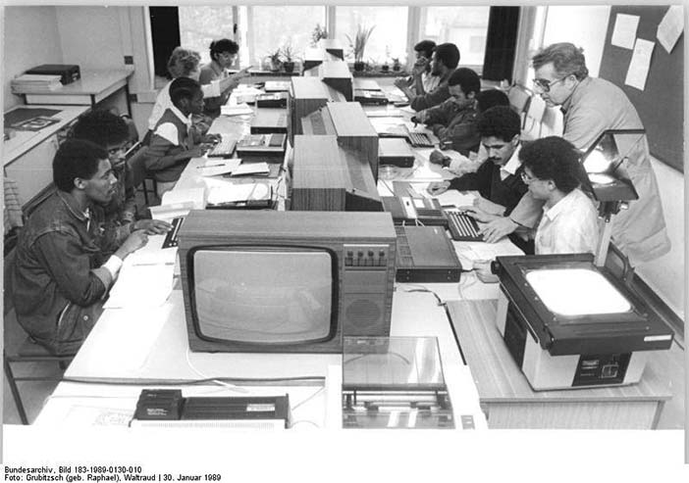
Why Study Human Use of Computer Systems? (4)
The Human Factors View:
Humans have necessary limitations.
Errors are costly in terms of:
loss of time
loss of money
loss of lives in critical systems
loss of morale
Good design can cope with such limitations!

Slide 30
Why Study Human Use of Computer Systems? (5)
The Social View:
Computers contribute to critical parts of our society, and cannot be ignored. To:
educate our children
take medical histories and provide expert advice
keep track of our credit worthiness
play out government strategies (and help form policies)
control air and ground traffic flow
book travel

Slide 31
The Social View continued
control chemical/oil/nuclear plants
control space missions
assist humans with their everyday tasks (office automation)
control complex machines (aircraft, space shuttles, super tankers)
help control consumer equipment (cars, washing machines)
entertainment (games, intellectual stimulation)…
In all these views, economics and human best interests are aligned.

Slide 32
Usability
Usability is generally regarded as ensuring that interactive products are easy to learn, effective to use and enjoyable from the user’s perspective.
Designing for maximum usability is the goal of design.

Slide 33
What is Usability?
Satisfaction
Learnability
Errors
Usability
Efficiency
Memorability

Slide 34
What is Usability? (2)
Usability can be defined as:
“The capacity to be used by humans easily and effectively where,
easily = to a specified level of subjective assessment
effectively = to a specified level of human performance” (Shackel, 1990)
Usability affords the user easy access to the product’s functions.

Slide 35
Usability Principles
Jakob Nielsen defined 10 usability principles that can be applied to any system, although frequently used for web applications
They are used mainly as the basis for evaluating systems for usability.

Slide 36
Neilsen’s 10 Heuristics
Visibility of system status
Match between system and the real world
User control and freedom
Consistency and standards.
Help users recognise, diagnose and recover from errors
Error prevention
Recognition rather than recall
Flexibility and efficiency of use
Aesthetic and minimalist design
Help and documentation

Slide 37
Nielsen’s Heuristics
Visibility of system status
Always keep users informed about what is going on, -> provide appropriate timely feedback within reasonable time.
What has been done?
Includes sound, highlighting, animation and combinations of these
“Cclihhck”
Principles

Slide 38
Nielsen’s Heuristics (2)
Web-site Visibility
The answers to the following questions should be obvious
Where am I?
What can I do?
Where will I go if I do this?
Where have I been?
‘Brand’ each page
Show the section it belongs to
Mark links to other pages clearly
If users may ‘jump’ to any part of the site from elsewhere, you need to include this status on every page.
Principles

Slide 39
Nielsen’s Heuristics (3)
2. Match between system and the real world
Speak the users’ language
Do not use system-oriented terms
Use real world conventions to make information appear in a natural and logical order
Use a technique called mapping: Relationship between controls and their movements and the results in the world
Principles

Slide 40
Nielsen’s Heuristics (4)
Why is this a poor mapping of control buttons?
Why is this a better mapping?
Principles

Slide 41
Nielsen’s Heuristics (5)
3. User control and freedom
Provide ways of allowing users to easily escape and navigate to/from places they unexpectedly find themselves - e.g.
Page Forward / Backward
Hold
Cancel
End / Stop
Help
Resume
Undo
Principles

Slide 42
Nielsen’s Heuristics (6)
A page needs a clearly marked "emergency exit”.
The browser provides "emergency exits”, but you can supply your own buttons to support user control and freedom.
A “Home" button on every page, perhaps.
Principles

Slide 43
Nielsen’s Heuristics (7)
4. Consistency and Standards
Avoid making users wonder whether different words, situations or actions means the same thing.
Design interfaces to have similar operations and use similar elements for similar tasks.
Main benefit - consistent interfaces are easier to learn, use and remember.
Principles

Slide 44
Nielsen’s Heuristics (8)
Follow ‘platform conventions’
Avoid confusion over whether different words, situations or actions mean the same thing to the user.
No ‘custom link’ colours on objects.
Web ‘standards’
Follow HTML specifications.
Deviations from the standards may result in unusable features.
Principles

Slide 45
Nielsen’s Heuristics (9)
Internal and external consistency
Internal consistency refers to designing operations to behave the same way within an application.
External consistency refers to designing operations, interfaces, etcetra to be the same across applications and devices.
Can you think of external inconsistencies?
.
Principles

Slide 46
Nielsen’s Heuristics (10)
A case of external inconsistency
(a) phones, remote controls
(b) calculators, computer keypads
1
2
3
7
8
9
4
5
6
4
5
6
7
8
9
1
2
3
0
0
Principles

Slide 47
Nielsen’s Heuristics (11)
5. Help users recognise, diagnose and recover from errors
Use plain language to describe the nature of the problem, and suggest a way of solving it.
Principles

Slide 48
Nielsen’s Heuristics (12)
Detection
Immediately detect all errors
Maintain the item in error
Visually highlight the item in error
Identify the field requiring missing data
Display error messages on the screen
Position the cursor at the first error
Use auditory signals conservatively
Correction
What guidelines for error correction are available?
Principles

Slide 49
Nielsen’s Heuristics (13)
6. Recognition, rather than recall
Make objects, actions and options visible.
From the point of view of the Web, this heuristic is closely related to ‘System Status’.
Principles

Slide 50
Nielsen’s Heuristics (14)
Recognition versus Recall uses the concept of Affordance →
What does this term refer to?
How can this be used in a system interface?
Principles

Slide 51
Nielsen’s Heuristics (15)
7. Error prevention
Prevent errors occurring in the first place, if possible.
Key question: Does the system prevent users from making serious errors, and if they do make an error, does it permit them to recover easily?
Principles

Slide 52
Nielsen’s Heuristics (16)
8. Flexibility and efficiency of use
Use accelerators (keyboard shortcuts).
Design for effective tasking – e.g. allowing the use of ‘Tab’ to move from cell to cell on a spreadsheet or database according to usage rules such as horizontal or vertical tabbing.
Principles

Slide 53
Nielsen’s Heuristics (17)
9. Aesthetic and minimalist design
Avoid using information that is irrelevant or rarely needed.
Irrelevant or rarely needed information in dialogues -> diminishes visibility.
Extraneous information on a page distracts the user and slows them down.
Use progressive levels of detail.
Principles

Slide 54
Nielsen’s Heuristics (18)
10. Help and documentation
Provide information that can be easily searched and provide help in a set of concrete steps that can easily be followed.
Principles

Slide 55

Now You Know That…
The HCI discipline includes the study of:
the use and context of computers
human characteristics
computer system and interface architecture
the development process
Why is it worthy studying?
HCI is worth studying because it aligns both human interests and economic interests

Slide 56
Summary of the Lecture
Introduction to the subject of HCI
Disciplines associated with HCI
Humans (Users) and Interfacing
Computers and Interfacing
Interaction
Reasons for our interest in HCI
Usability Principles (Nielsen's Heuristics)

Slide 57
References
Preece, J. et al. (2002) Interaction Design
Shneiderman, B. & Plaisant, C. (2005) Designing the User Interface
Benyon, D. et al (2005) Designing Interactive Systems
Wyeth, P. & Purchase, H. (2003) Using Developmental Theories to Inform the Design of Technology for Children
Hawthorn, D. (2003) How Universal is Good Design for Older Users
Nielsen, J. (1995) Advances in Human-Computer Interaction
Shackel, B. (1990) Human Factors and Usability

